Slide 1
Generative Music
Ethan Ooi

Slide 2
Basic Problem
How to generate music that sounds good??

Slide 3
Basic Music Theory
Every song is in a key
This key represents a set of 7 notes that compose of its scale
This scale is a set of notes that repeats itself.
Songs are made up of chords, which are notes played together to give a specific musical color
Modal chords are chords that be constructed using repeating intervals from a given scale.

Slide 4
Example of a Scale
C D E F G A B C

Slide 5
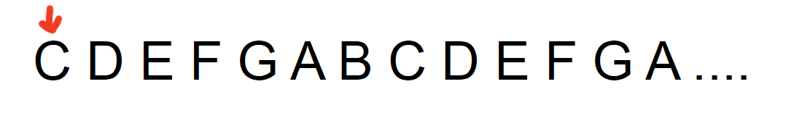
How are chords constructed?
Lets generate a C Major 7 chord
C is selected as first note
Chord Notes: [C,]

Slide 6
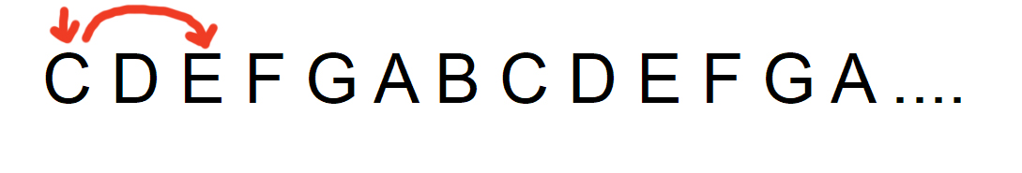
How are chords constructed?
Lets generate a C Major 7 chord
E is selected as the note a "third" away
Chord Notes: [C,E]

Slide 7
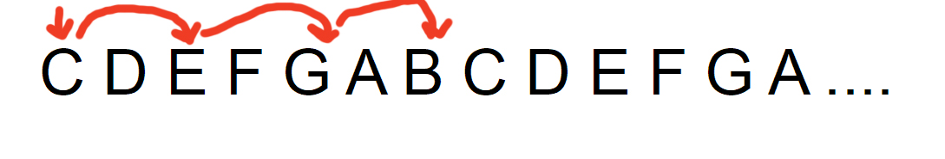
How are chords constructed?
Lets generate a C Major 7 chord
G and B are picked up in the same way.
Chord Notes: [C,E,G,B]
Done

Slide 8
EXAMPLE: Play a song and Recite a Song

Slide 9
Road to "good" Music Generation
Generate valid chords
Generate consonant chord changes (Least Note Movement)
Generate consonant key changes (Least scale changes)
Generate interesting yet valid rhythms (Polyrhythms)

Slide 10
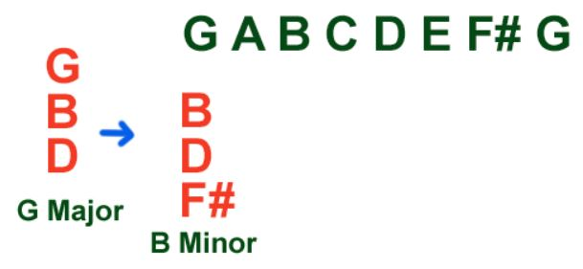
Consonant Chord Changes
The goal is to change from one chord to the next by changing the least amount of notes.

Slide 11
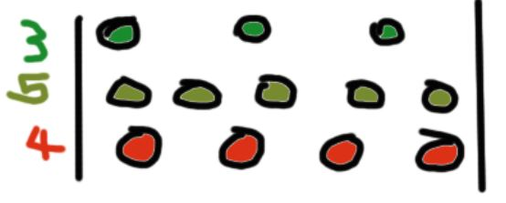
Polyrhythms

Slide 12
POLYRHYTHM EXAMPLE
Now I will show how polyrhythms and consonant chord changes can be combines

